Slide 1
Reporting & Learning Dr Neil McGuire FRCA FFICM FFMLM Clinical Director of Devices, Medicines and Healthcare products Regulatory Agency

Slide 2
Key Findings
Reporting of life-threatening perioperative anaphylaxis to local reporting systems, and thence to the National Reporting and Learning System (NRLS), occurs in 70% of cases
Reporting is usually by the index anaesthetist
Reporting to the UK regulatory system, the Medicines and Healthcare products Regulatory Agency (MHRA), is poor, occurring in fewer than one quarter of cases
From a general public health perspective, the potential value of reporting to the MHRA is much greater than that of local reporting
Current reporting levels and processes mean that data held by the MHRA are unlikely to be representative of the prevalence of perioperative anaphylaxis, and that data on suspected trigger agents are highly likely to be inaccurate
Steps are needed to improve the ease of reporting and to remove barriers to this.
A lack of feedback from the NRLS and MHRA may negatively impact on reporting rates.
Combining relevant data from the NRLS and MHRA (taking care to avoid double-reporting of cases) may have considerable benefit

Slide 3
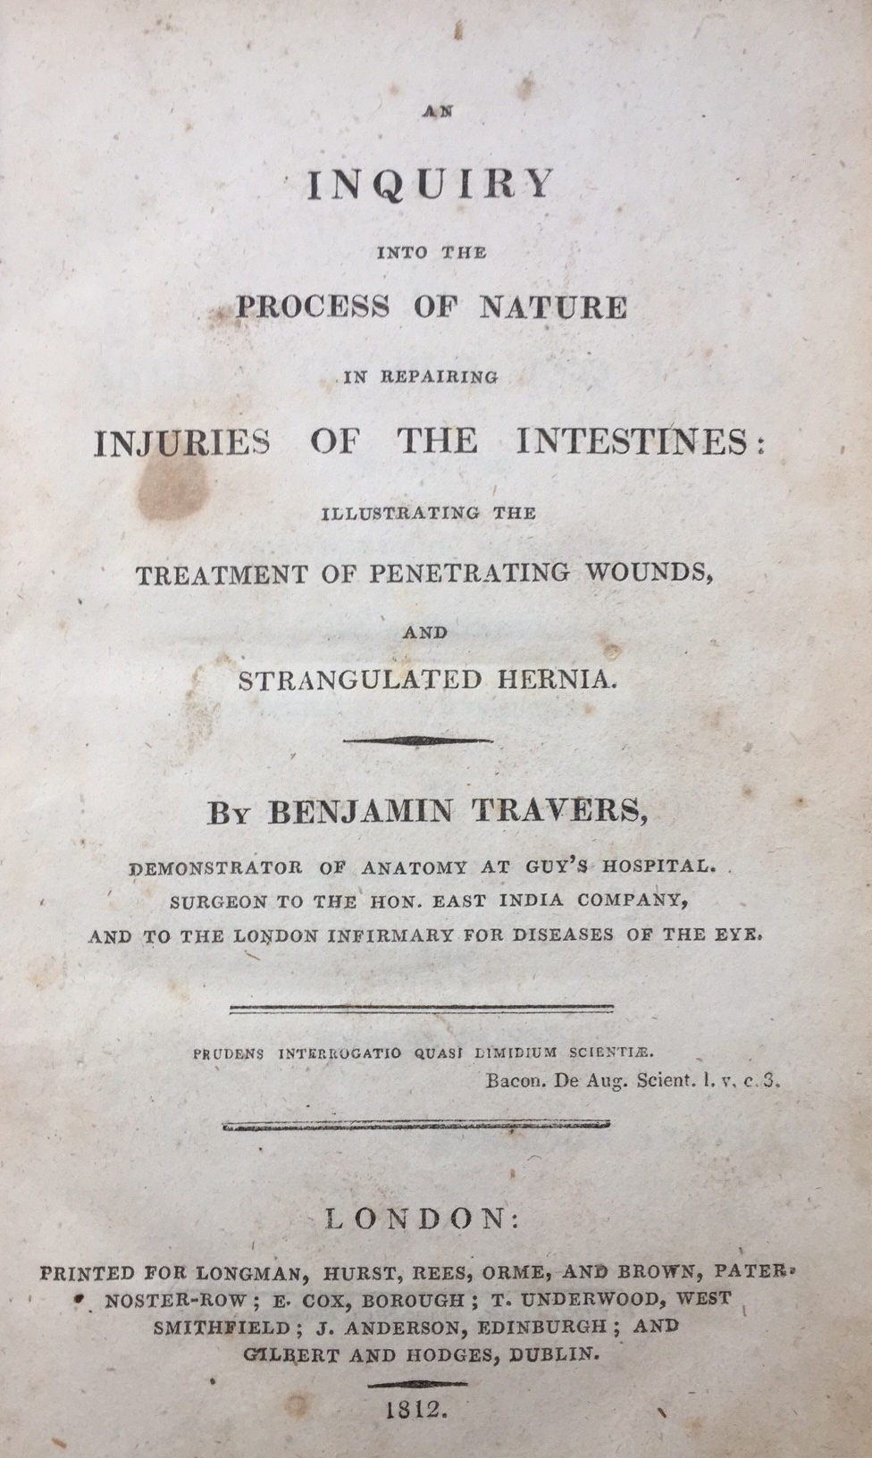
Reporting Systems?
“Without principles, practice is a mere routine; the good or ill results of which the cause is not discerned, are equally lost to the progress of Art. The success which cannot explain often leads us into error, and serves only to perpetuate, under the names of experience, a blind conduct, of which we know neither the good nor the evil.”
Benjamin Travers, Surgeon to the Honourable East India Company, 1812.

Slide 4
Analysis of NAP 6 reporting
In all cases, reporting to the MHRA occurred in 15.8% of cases before attending the allergy clinic and in 23.7% after the clinic visit
In children, reporting to the MHRA occurred in 9.1% of cases before attending the allergy clinic and in 18.2% after the clinic visit.
Seventy per cent of cases included in NAP6 were reported to trust reporting systems
In the vast majority of cases reporting was by the index anaesthetist

Slide 5
Who reported to MHRA?
Index anaesthetists were responsible for 44% of reports before allergy clinic assessment
Local Coordinators accounted for 14%
Others who reported:
Another anaesthetist (7)
Pharmacists (2)
ICU doctors (1)

Slide 6
Who reported to MHRA?
Index anaesthetists were responsible for 44% of reports before allergy clinic assessment
Local Coordinators accounted for 14%
Others who reported:
Another anaesthetist (7)
Pharmacists (2)
ICU doctors (1)
Of the ten deaths, only three were reported to MHRA

Slide 7
What’s happening at MHRA?
MHRA received 901 reports of suspected ‘anaphylactic or anaphylactoid reactions’ via the Yellow Card system*
464 (51%) could potentially have occurred during the perioperative period. For some drug groups it is highly likely many did not.
Antibiotics may have been administered at any time
Many other drugs included in miscellany are also used in non-perioperative settings
Reports to MHRA included some likely anomalous reports such as reactions to:
Sevoflurane
Sodium chloride
Water
Steroids
Adrenaline
We are not aware of the grades of reactions reported, nor the degree of suspicion of anaphylaxis. It is of course inevitable that many of these reactions were not hypersensitivity reactions
*In the year January to December 2016

Slide 8
Comparison with NAP6?
Very difficult to compare these data with NAP6 data. There were, however significant numbers of reactions to:
Co-amoxiclav (35)
Teicoplanin (72)
Amoxicillin (20)
Rocuronium (34), atracurium (27)
Suxamethonium (17)
Chlorhexidine (22)
Patent Blue (17)
All of which ranked in the top 11 most frequently reported drugs and between them accounted for 27% of all reports

Slide 9
Utopia vs Reality
Utopia
All interventions are:
Straightforward
Do not require training, skill and knowledge to undertake
Are undertaken when desired and necessary
Undertaken in ideal circumstances in patients free from comorbidities
Successful
Free from any hazard, either predictable or not, in the:
Short (perioperative)
Intermediate
Long term
Never accompanied by disease progression or subsequent illness

Slide 10
Elements of good reporting?
All incidents which could have led to harm should be reported, (to ensure today’s near-miss does not turn out to be tomorrow’s disaster)
Information reported must be:
Accurate
Timely
Succinct/manageable
Include everything being requested by the reporting system to ensure consistency
Data should be reviewed promptly
Data should be only what is required, and should only need to be entered once
Data should be analysed regularly to identify trends and emerging hazards

Slide 11
How can we learn from data?
Identify critical incidents, trends, emerging issues
Audit, for monitoring performance of:
The individual
The team
The healthcare institution
Monitoring the introduction of new processes or procedures
Also when learning we also can:
Reduce the likelihood of litigation by preventing safety issues going unnoticed
Fulfill a doctor’s obligation to the GMC (GMC 2014)
Enable healthcare institutions to fulfil their obligations to patient safety as determined in the Health and Social Care Act 2008 and other regulatory updates (CQC 2015)

Slide 12
Barriers to reporting
A lack of perceived or actual value in the eyes of the potential reporter
Poor education regarding the value and methods of reporting
Difficult or time-consuming data entry
A requirement to enter excessive or unnecessary data
Absence of feedback from reporting systems
Failure to provide advice on what action is to be taken
Requirements to report to more than one system
Lack of resources for reporting

Slide 13
How can we encourage reporting?
Action should be undertaken in a timely way where this is deemed necessary
There should be feedback to the reporters/teams involved. This will vary in detail, but must include some element of what action is to be taken, even if this is just to be mapping of trending and continuing surveillance
Reporters should have a voice in what is being collected, and be confident of its value
Sufficient resources should be given to reporters to undertake reporting activities.
We know reporting improves in a no-blame culture.

Slide 14
NAP6 Recommendations:
National
MHRA should improve communication with clinicians; for example, providing an annual report which includes perioperative anaphylaxis
Institutional
The departmental lead should ensure all cases have been reported to the trust’s incident reporting system
The departmental lead should ensure all cases are reported (by the anaesthetist encountering the reaction, or the departmental lead) to the MHRA as soon as possible after the event, and record the MHRA case identifier for future reference
The departmental lead should (using the MHRA case identifier) ensure the MHRA record is updated after allergy clinic investigation is completed to ensure the information held is accurate
Individual
The departmental lead should be informed of the case
The MHRA case identifier should be included in the referral to the allergy clinic
All cases of Grades 3–5 perioperative anaphylaxis should be presented and discussed at local Morbidity and Mortality meetings for purposes of education and familiarisation

Slide 15
Messages around reporting
Conversation should start with:
‘What happened within the system facilitating this set of circumstances?’
Not ‘Who’s to blame and how were they allowed to do this?’
Reporting of serious incidents and near-misses are essential to the understanding of untoward events occurring in healthcare
Without data we will miss opportunities to detect and potentially mitigate issues which could be more common than we perceive
Reporting of untoward events and near-misses is a professional responsibility of all healthcare professionals
This means:
Everyone involved in healthcare has a part to play in reporting
Strong leadership by medical professionals is essential
A permissive environment and a culture of reporting
This can only be fostered by using data generated as a learning opportunity, and not as part of a vehicle to blame individuals where an error by a healthcare professional is seen to be the root cause of an issue

Slide 16
MHRA reporting
The MHRA Yellow Card scheme is for medicines and devices.
It can be accessed for reporting online and by phone, post or app (only medicines)
https://yellowcard.mhra.gov.uk
NHS Improvement also provides guidance on reporting patient-safety incidents

Slide 17
Thank you

